Slide 1
Introduction to Convex Optimization
(Sejong RCV 임근택)

Slide 2
Why Convex Optimization?

Slide 3
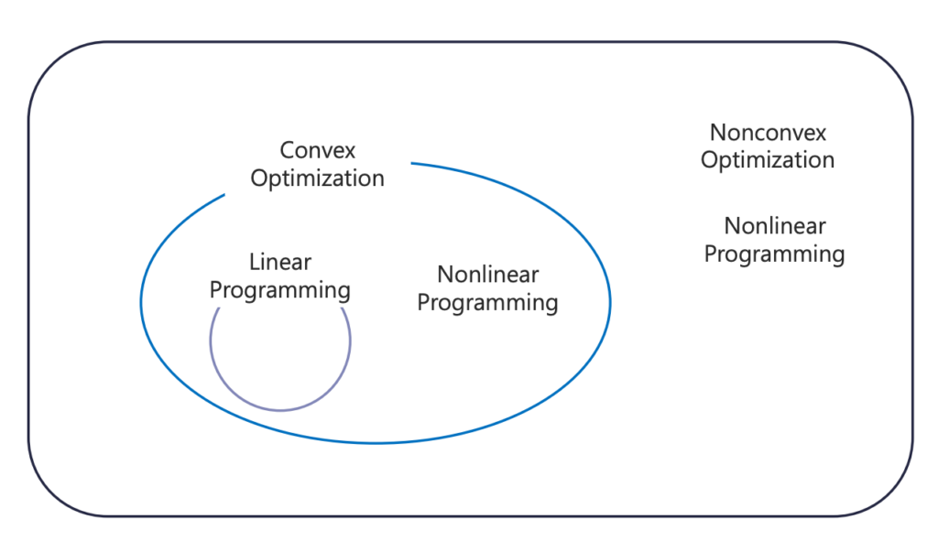
Optimization Problems

Slide 4
Convex Sets & Function

Slide 5


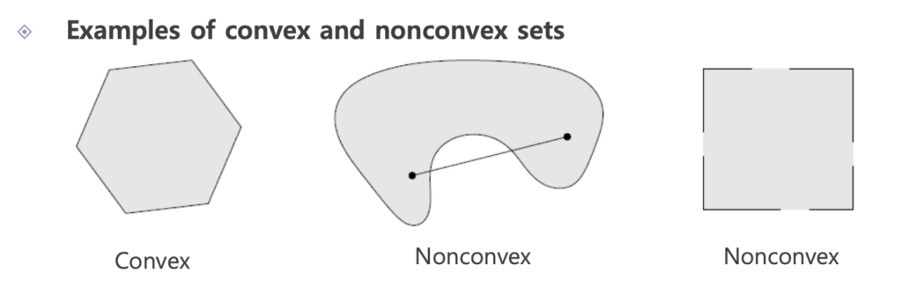
Convex Set
Affine Set :
Convex Set :

Slide 6
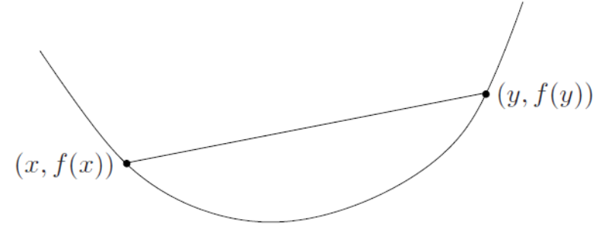
Convex Function
Convex Function :

Slide 7
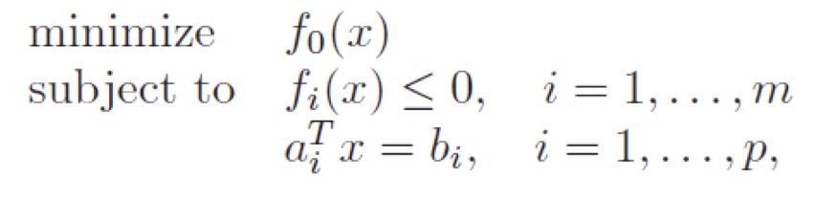
Convex Optimization
The objective function must be convex
The inequality constraint function must be convex
The equality constraint function must be affine
The feasible set of a convex optimization problem is convex

Slide 8



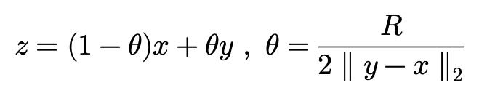




Global optimal = local optimal
Suppose that x is locally optimal point and x is feasible
$$x$$
$$R$$
$$y$$
Suppose that x is not globally optimal there is a feasible point y such that
Consider the point z given by
By Convexity of the function we can have

Slide 9
Unconstrained Convex Optimization

Slide 10

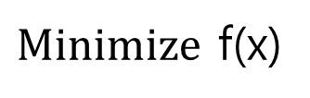
Unconstrained Convex Optimization
$Minimize$ f(x)

Slide 11





Example : Least Square
Vector Differentiation

Slide 12
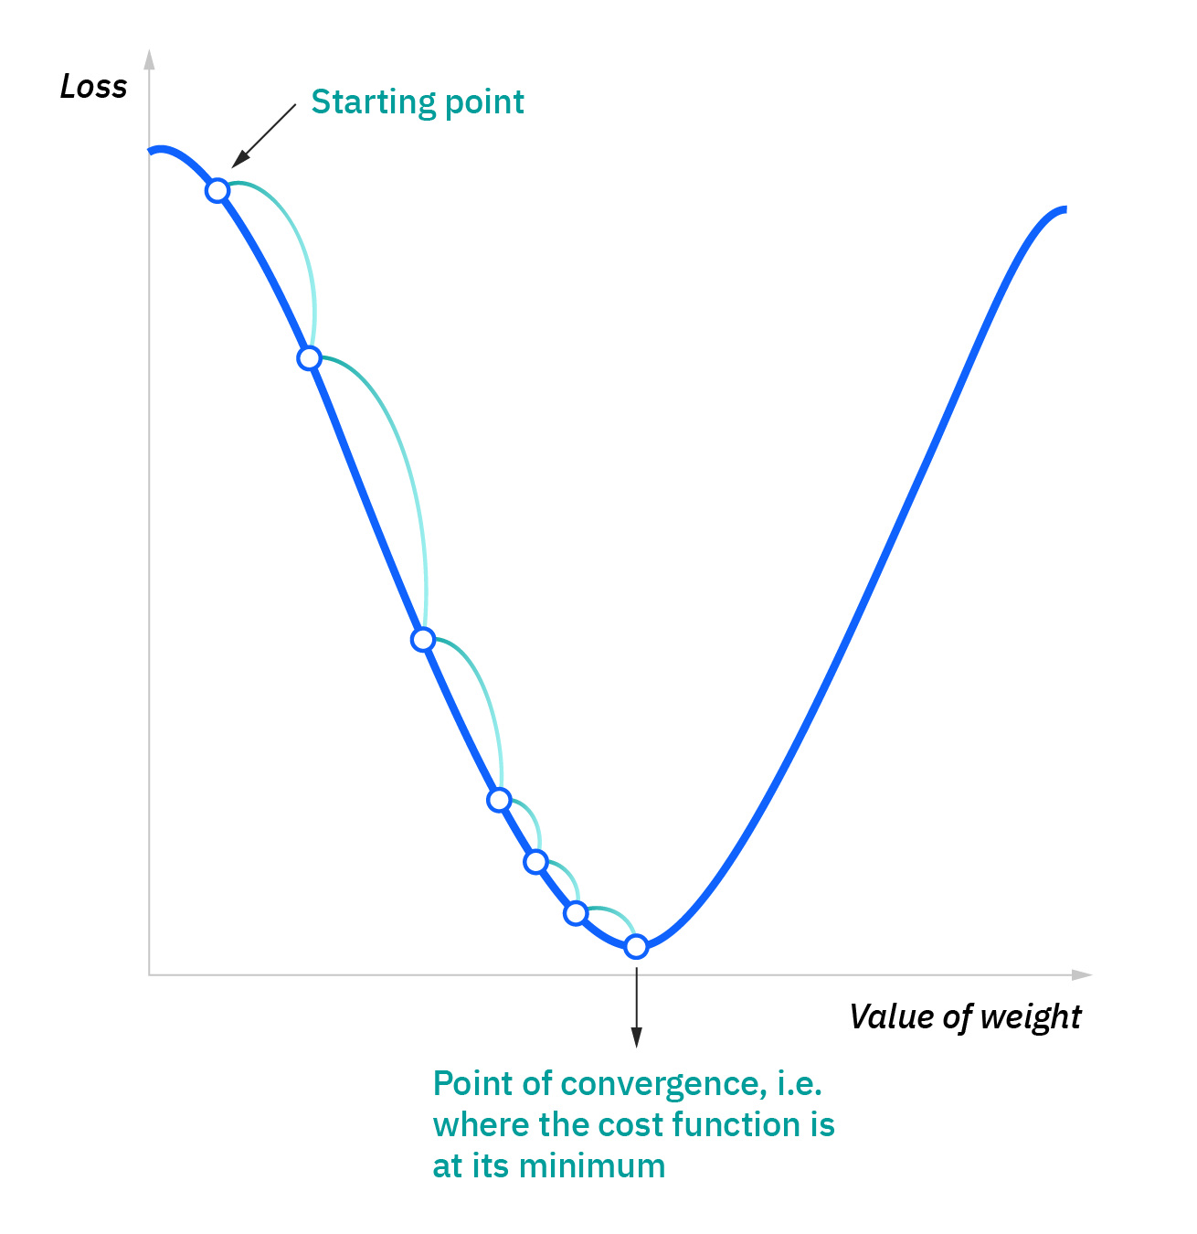
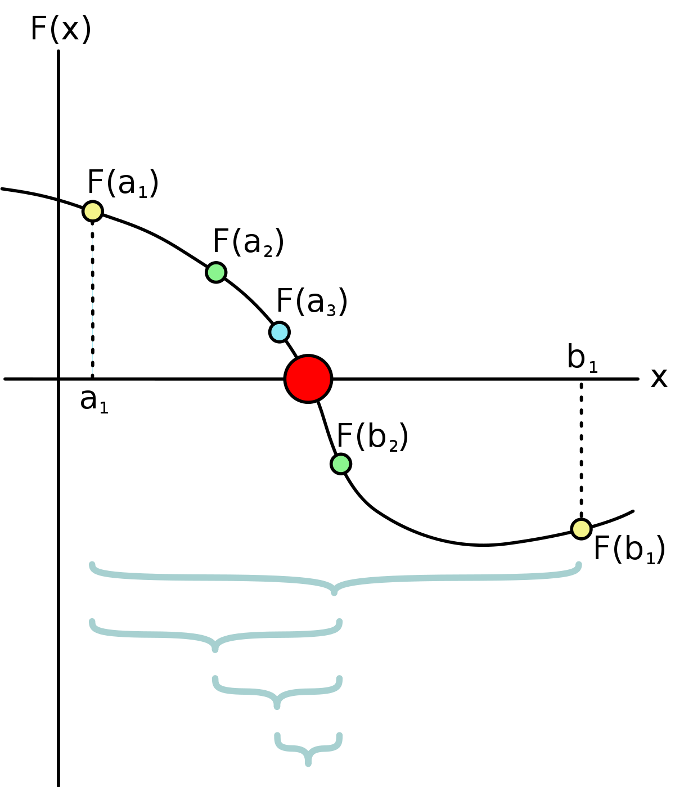
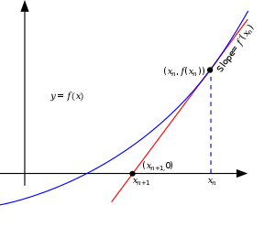
Unconstrained Convex Optimization (Numerical)
Bisection method
Newton’s method
Gradient Descent
To calculate roots of gradient, the exact solution may not be calculated.
So, sometimes we use numerical approach

Slide 13
Constrained Convex Optimization

Slide 14
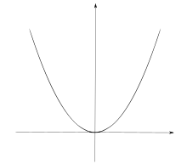
Constrained Convex Optimization
Unconstrained
Constrained

Slide 15
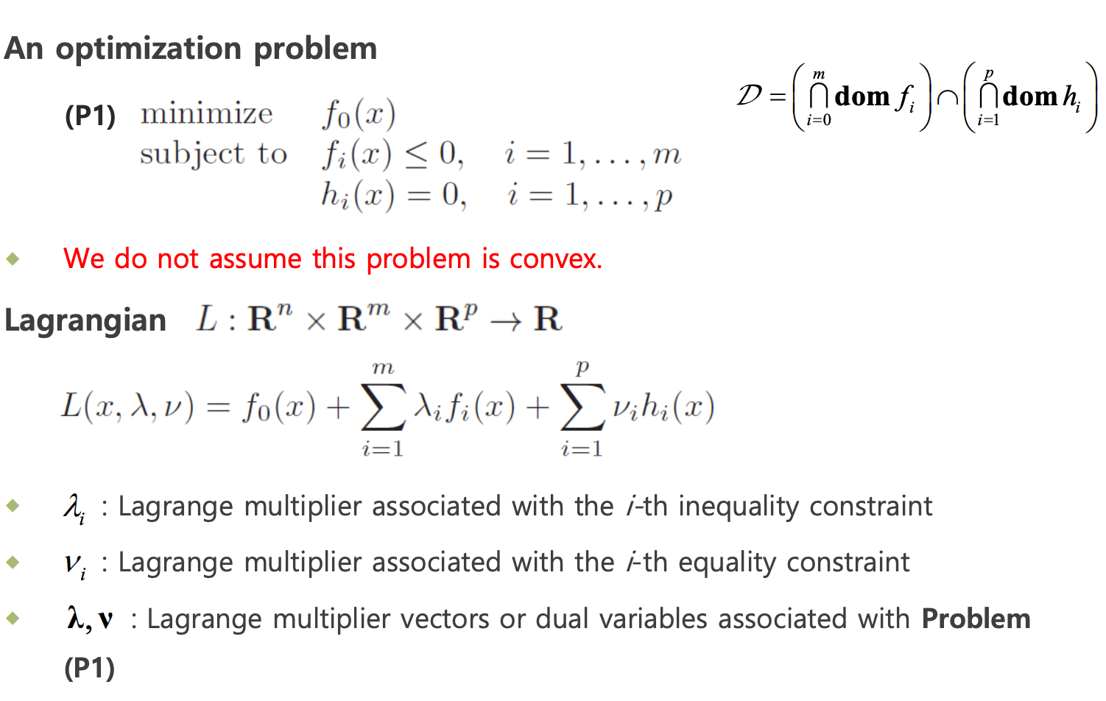
Lagrange multiplier

Slide 16
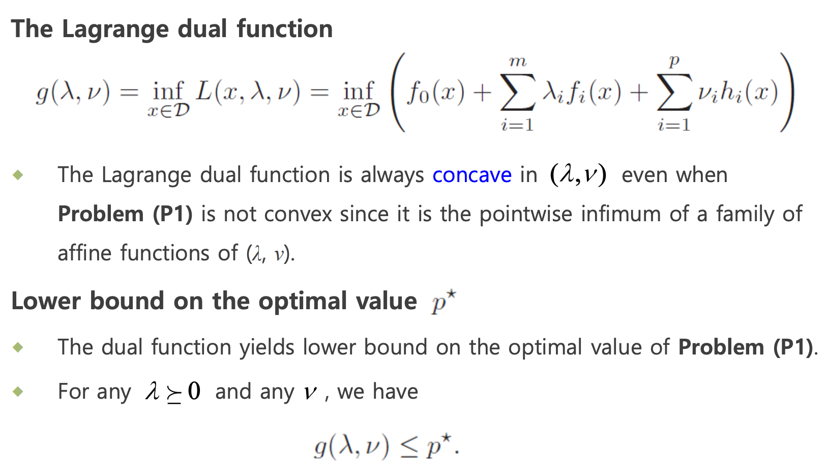
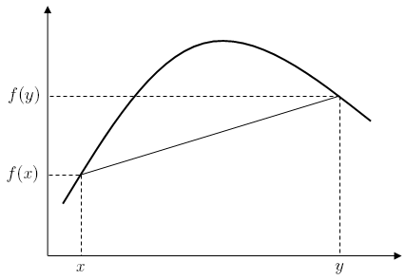
Lagrange Dual Function
Concave function

Slide 17
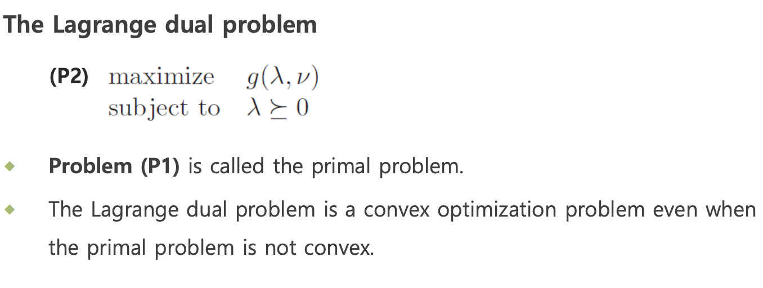
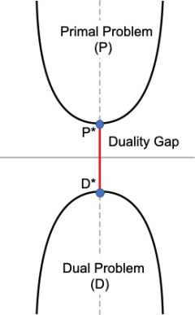
Lagrange Dual Problem
Duality Gap

Slide 18
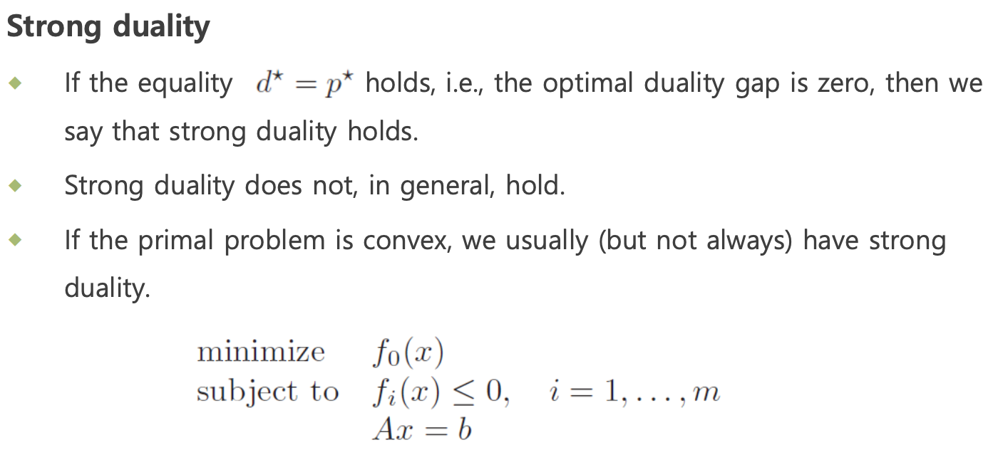
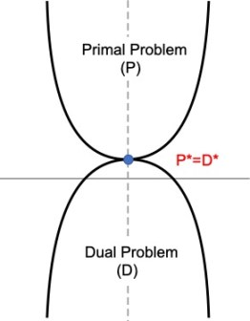
Strong Duality
Strong duality

Slide 19
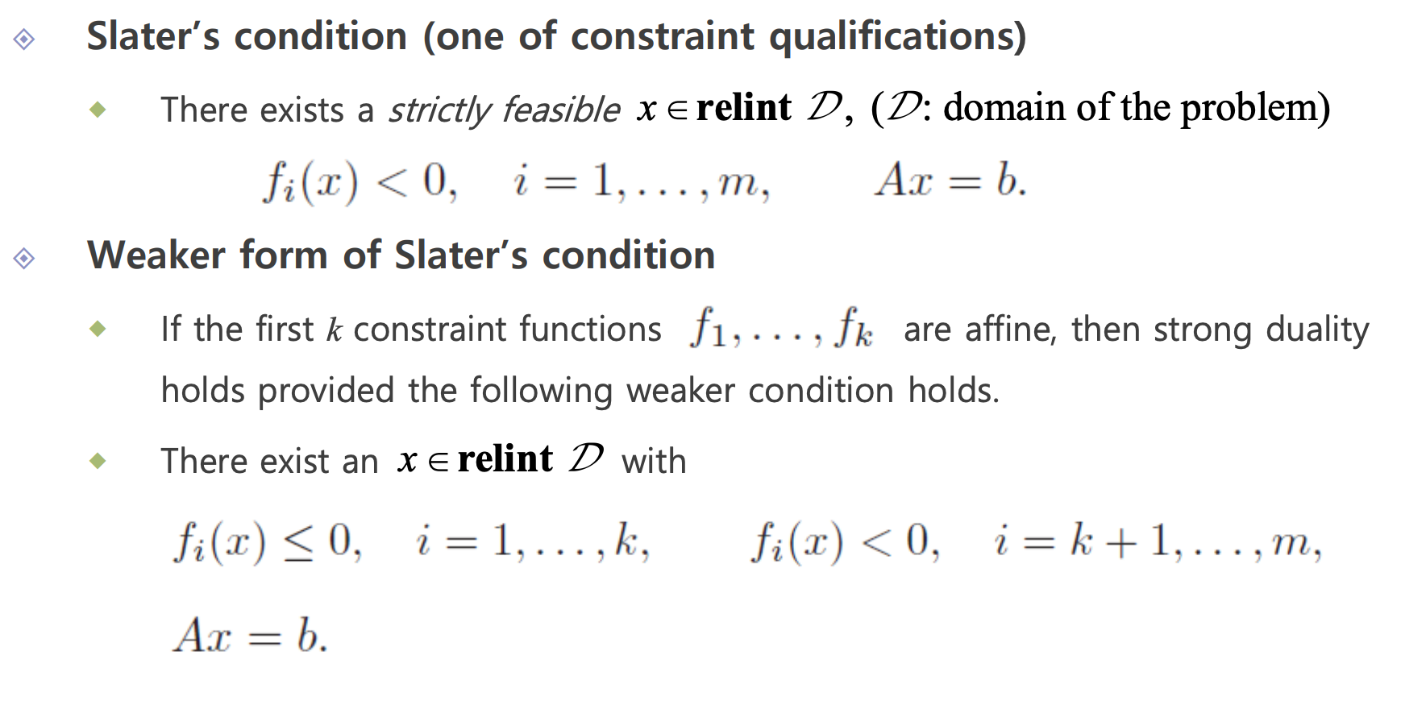
Slater’s condition
Strong duality

Slide 20
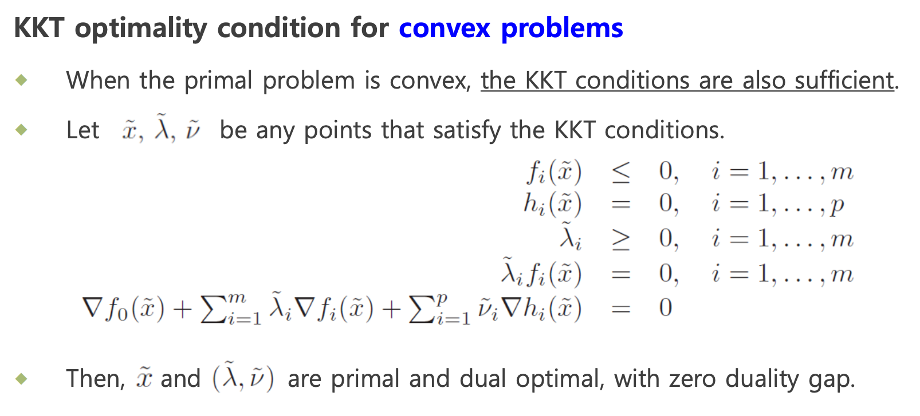
Karush-Kuhn-Tucker condition(KKT condition)

Slide 21
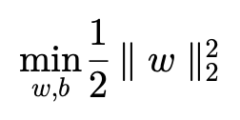
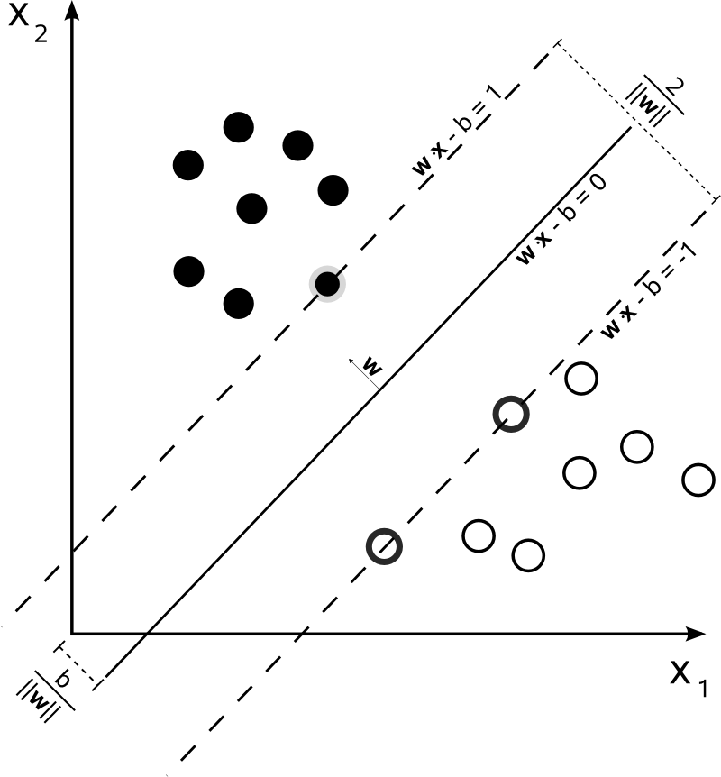

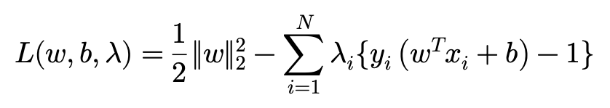
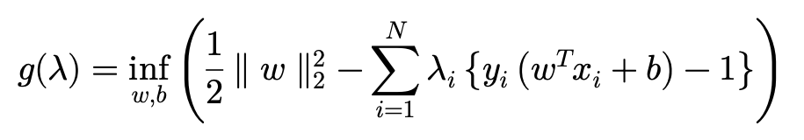
Example : Support Vector Machine(SVM)
Derive Dual Function

Slide 22
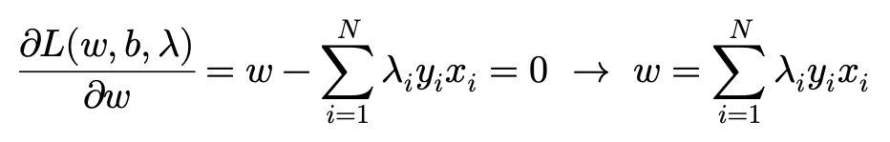
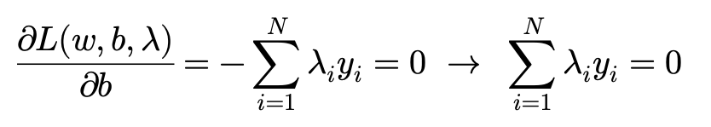
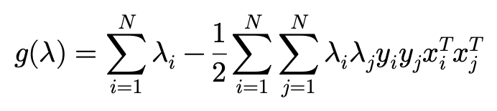
Example : Support Vector Machine (Dual Function)
Substitute

Slide 23
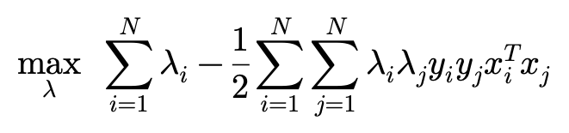
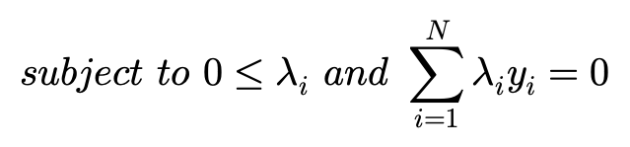
Example : Support Vector Machine (Dual Problem)

Slide 24
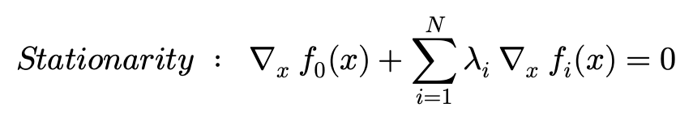


Example : Support Vector Machine (KKT condition)

Slide 25
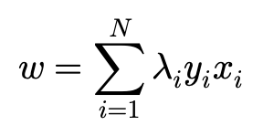
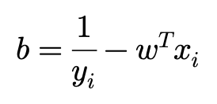
Example : Support Vector Machine (KKT condition)

